Slide 1
CSE 403
Lecture 9
UML State Diagrams
Reading:
UML Distilled, Ch. 10, M. Fowler
slides created by Marty Stepp
http://www.cs.washington.edu/403/

Slide 2
UML state diagrams
state diagram: Depicts data and behavior of a single object throughout its lifetime.
  set of states (including an initial start state)
  transitions between states
  entire diagram is drawn from that object's perspective
similar to finite state machines (DFA, NFA, PDA, etc.)
What objects are best used with state diagrams?
  large, complex objects with a long lifespan
  domain ("model") objects
  not useful to do state diagrams for every class in the system!

Slide 3
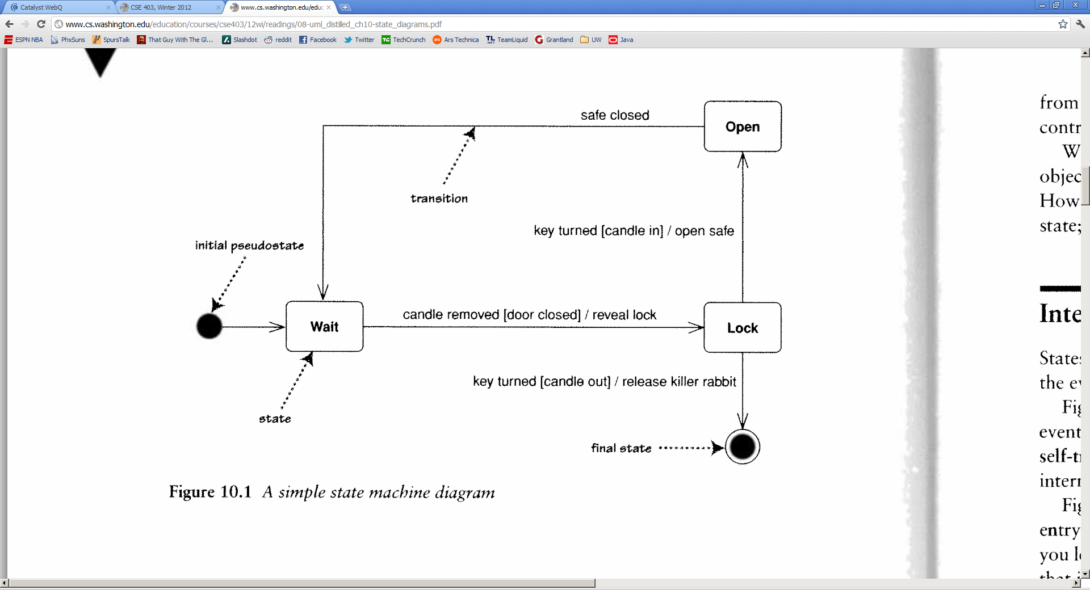
State diagram example

Slide 4
States
state: conceptual description of the data in the object
  represented by object's field values
entire diagram is drawn from the
central object's perspective
  only include states / concepts that
  this object can see and influence
  don't include every possible value
  for the fields; only ones that are
  conceptually different

Slide 5
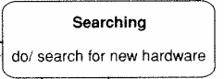
Transitions
transition: movement from one state to another
signature [guard] / activity
  signature: event that triggers (potential) state change
  guard: boolean condition that must be true
  activity: any behavior executed during transition (optional)
transitions must be mutually exclusive (deterministic)
  must be clear what transition to take for an event
  most transitions are instantaneous,
  except "do" activities

Slide 6
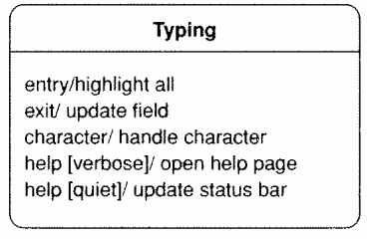
Internal activities
internal activity: actions that the
central object takes on itself
  sometimes drawn as self-transitions
  (events that stay in same state)
entry/exit activities
  reasons to start/stop being in that state

Slide 7
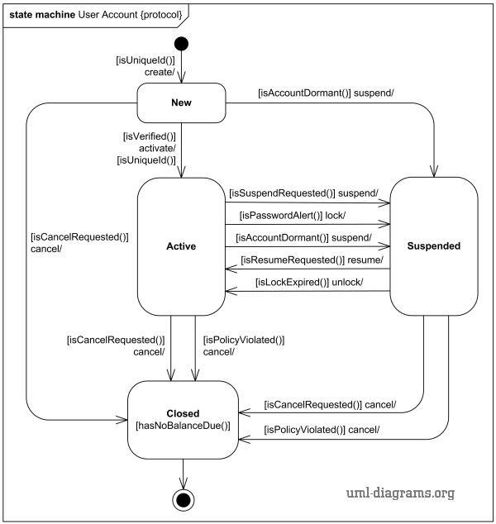
State diagram example
User account management

Slide 8
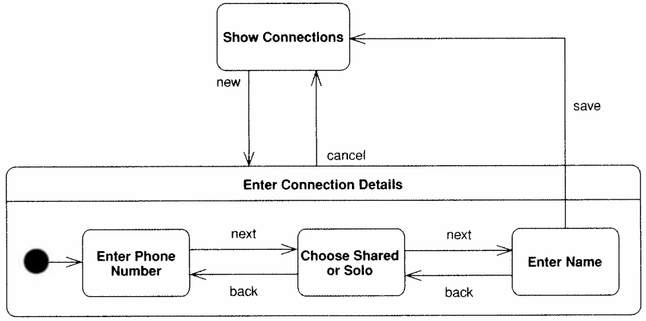
Super/substates
When one state is complex, you can include substates in it.
  drawn as nested rounded rectangles within the larger state
Caution: Don't over-use this feature.
  easy to confuse separate states for sub-states within one state

Slide 9
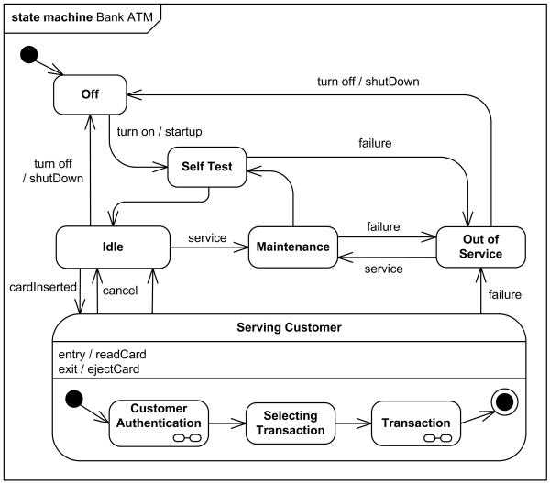
State diagram example
ATM software states at a bank

Slide 10
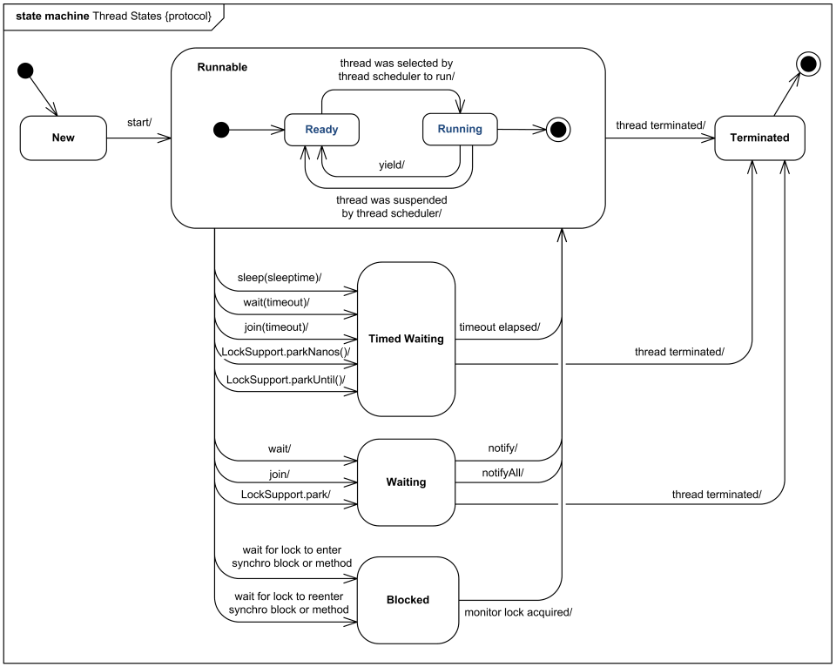
State diagram example
Java thread states

Slide 11
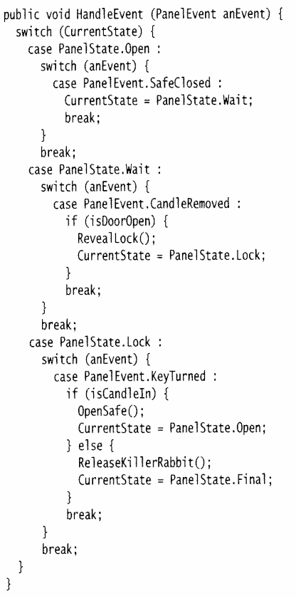
Implementing states
What are some ways to write
code to match a state diagram?
  state tables (pseudo-code)
  nested if/else
  switch statements
  state enums
  State design pattern

Slide 12
State pattern
state pattern: An object whose sole purpose is to represent the current "state" or configuration of another larger object.
  A behavioral pattern.
  Often implemented with an enum type for the states.
  Each object represents one specific state for the larger object.
  The larger object sets its state in response to various mutations.
  Allows various observers and interested parties to quickly and accurately know what is going on with the larger object's status.
Analogous to the notion of finite state machines.
  Set of states (nodes)
  Set of edges (mutations that cause state changes)
Notes:
difference from Command pattern:
command objects each solve different problems
strategy objects all solve the same problem in different ways

Slide 13
State enum example
/** Represents states for a poker game. */
public enum GameState {
NOT_STARTED, IN_PROGRESS, WAITING_FOR_BETS,
DEALING, GAME_OVER;
}
/** Poker game model class. */
public class PokerGame {
private GameState state;
public GameState getState() { return state; }
public void ante(int amount) {
...
state = WAITING_FOR_BETS; // change state
setChanged();
notifyObservers(state);
}
}

